Slide 1
Chapter 2: Boolean Algebra and Logic Gates

Slide 2
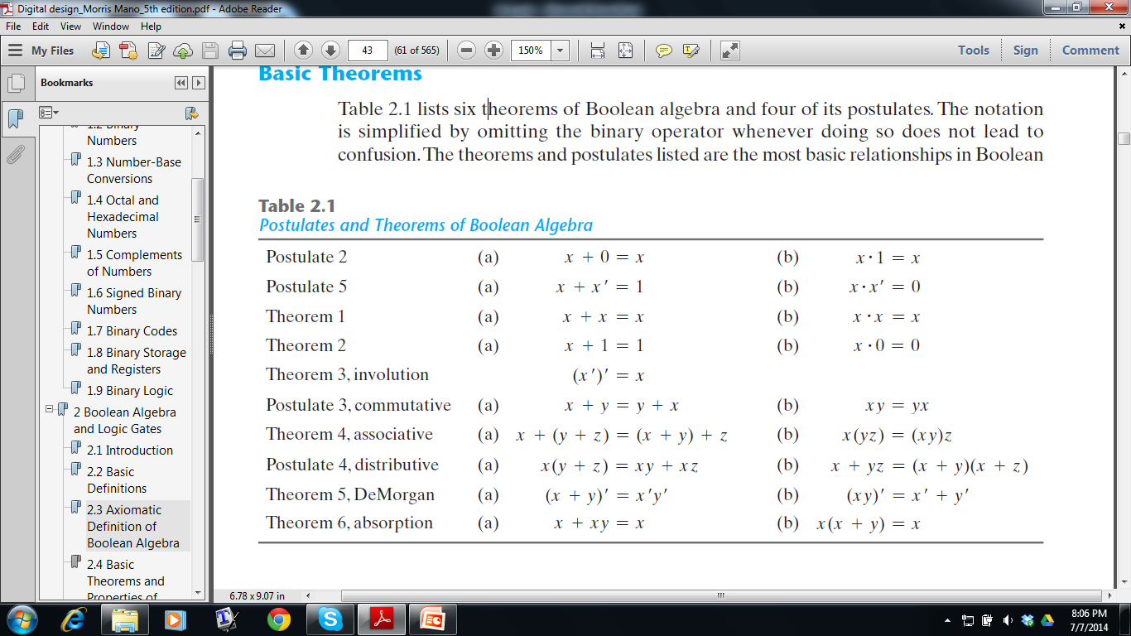

Slide 3
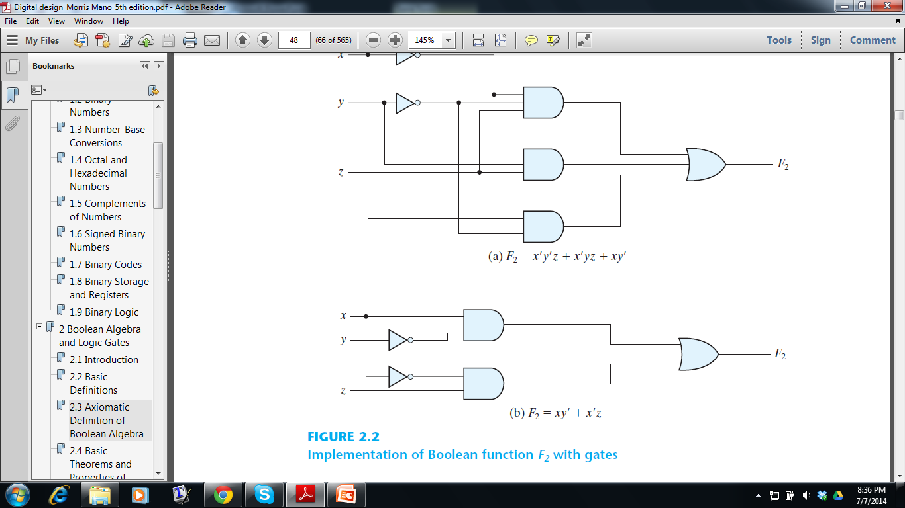
F₁= XY’ + X’Z
X | Y | Z | X’ | Y’ | XY’ | X’Z | F₁
0 | 0 | 0 | 1 | 1 | 0 | 0 | 0
0 | 0 | 1 | 1 | 1 | 0 | 1 | 1
0 | 1 | 0 | 1 | 0 | 0 | 0 | 0
0 | 1 | 1 | 1 | 0 | 0 | 1 | 1
1 | 0 | 0 | 0 | 1 | 1 | 0 | 1
1 | 0 | 1 | 0 | 1 | 1 | 0 | 1
1 | 1 | 0 | 0 | 0 | 0 | 0 | 0
1 | 1 | 1 | 0 | 0 | 0 | 0 | 0
F₁

Slide 4
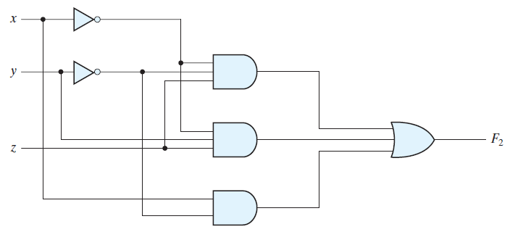
F₂= X’Y’Z + X’YZ + XY’
X | Y | Z | X’ | Y’ | X’Y’Z | X’YZ | XY’ | F₂
0 | 0 | 0 | 1 | 1 | 0 | 0 | 0 | 0
0 | 0 | 1 | 1 | 1 | 1 | 0 | 0 | 1
0 | 1 | 0 | 1 | 0 | 0 | 0 | 0 | 0
0 | 1 | 1 | 1 | 0 | 0 | 1 | 0 | 1
1 | 0 | 0 | 0 | 1 | 0 | 0 | 1 | 1
1 | 0 | 1 | 0 | 1 | 0 | 0 | 1 | 1
1 | 1 | 0 | 0 | 0 | 0 | 0 | 0 | 0
1 | 1 | 1 | 0 | 0 | 0 | 0 | 0 | 0

Slide 5
X | Y | Z | F₁ | F₂
0 | 0 | 0 | 0 | 0
0 | 0 | 1 | 1 | 1
0 | 1 | 0 | 0 | 0
0 | 1 | 1 | 1 | 1
1 | 0 | 0 | 1 | 1
1 | 0 | 1 | 1 | 1
1 | 1 | 0 | 0 | 0
1 | 1 | 1 | 0 | 0
F₁
F₁= XY’ + X’Z
F₂= X’Y’Z + X’YZ + XY’

Slide 6
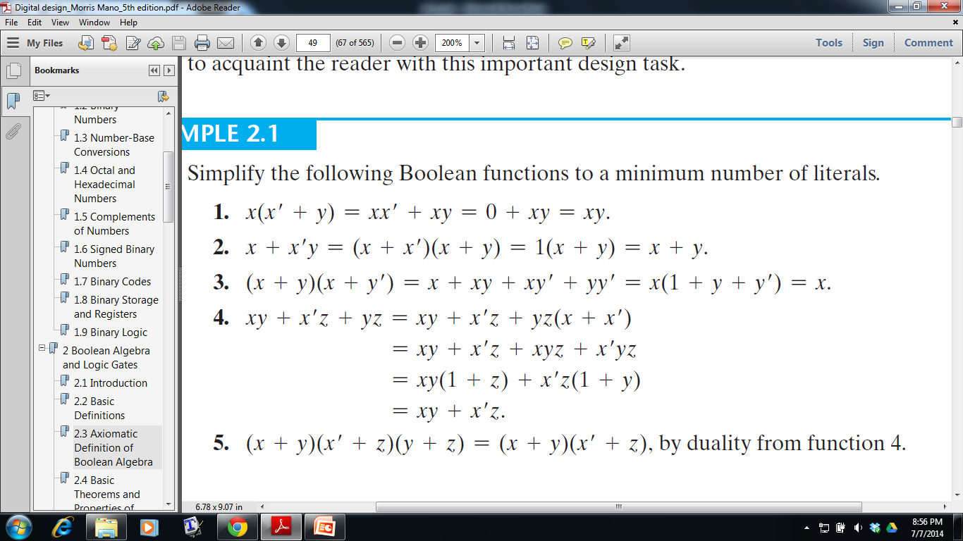
F(x, y, z) = xy + x’z + yz
= xy + x’z + yz.1
By Postulate 5(a)
By Postulate 4(a)
By Theorem 2

Slide 7
CANONICAL FORMS
How to express a boolean function algebraically from a given truth table?
X | Y | Z | F
0 | 0 | 0 | 0
0 | 0 | 1 | 1
0 | 1 | 0 | 0
0 | 1 | 1 | 1
1 | 0 | 0 | 1
1 | 0 | 1 | 1
1 | 1 | 0 | 0
1 | 1 | 1 | 0
F(x,y,z)=?

Slide 8
Summation of Minterms
F(x,y,z)=?
X | Y | Z | Term | Designation | F
0 | 0 | 0 | X’Y’Z’ | m₀ | 0
0 | 0 | 1 | X’Y’Z | m₁ | 1
0 | 1 | 0 | X’YZ’ | m₂ | 0
0 | 1 | 1 | X’YZ | m₃ | 1
1 | 0 | 0 | XY’Z’ | m₄ | 1
1 | 0 | 1 | XY’Z | m₅ | 1
1 | 1 | 0 | XYZ’ | m₆ | 0
1 | 1 | 1 | XYZ | m₇ | 0

Slide 9
Summation of Minterms
F(x,y,z)= m₁+ m₃ + m₄ + m₅ = X’Y’Z+X’YZ+XY’Z’+XY’Z =∑(1, 3, 4, 5)
X | Y | Z | Term | Designation | F
0 | 0 | 0 | X’Y’Z’ | m₀ | 0
0 | 0 | 1 | X’Y’Z | m₁ | 1
0 | 1 | 0 | X’YZ’ | m₂ | 0
0 | 1 | 1 | X’YZ | m₃ | 1
1 | 0 | 0 | XY’Z’ | m₄ | 1
1 | 0 | 1 | XY’Z | m₅ | 1
1 | 1 | 0 | XYZ’ | m₆ | 0
1 | 1 | 1 | XYZ | m₇ | 0

Slide 10
Summation of Minterms
F(x,y,z)= m₁+ m₃ + m₄ + m₅ = X’Y’Z+X’YZ+XY’Z’+XY’Z =∑(1, 3, 4, 5)
F’ = m₀ + m₂ + m₆ + m₇ = X’Y’Z’+X’YZ’+XYZ’+XYZ
X | Y | Z | Term | Designation | F
0 | 0 | 0 | X’Y’Z’ | m₀ | 0
0 | 0 | 1 | X’Y’Z | m₁ | 1
0 | 1 | 0 | X’YZ’ | m₂ | 0
0 | 1 | 1 | X’YZ | m₃ | 1
1 | 0 | 0 | XY’Z’ | m₄ | 1
1 | 0 | 1 | XY’Z | m₅ | 1
1 | 1 | 0 | XYZ’ | m₆ | 0
1 | 1 | 1 | XYZ | m₇ | 0

Slide 11
Multiplication of Maxterms
F(x,y,z)=?
X | Y | Z | Term | Designation | F
0 | 0 | 0 | X + Y + Z | M₀ | 0
0 | 0 | 1 | X + Y + Z’ | M₁ | 1
0 | 1 | 0 | X + Y’ + Z | M₂ | 0
0 | 1 | 1 | X + Y’ + Z’ | M₃ | 1
1 | 0 | 0 | X’ + Y + Z | M₄ | 1
1 | 0 | 1 | X’ + Y + Z’ | M₅ | 1
1 | 1 | 0 | X’ + Y’ + Z | M₆ | 0
1 | 1 | 1 | X’ + Y’ + Z’ | M₇ | 0

Slide 12
Multiplication of Maxterms
By MinTerms, F = m₁+ m₃ + m₄ + m₅ = X’Y’Z+X’YZ+XY’Z’+XY’Z
F’ = m₀ + m₂ + m₆ + m₇ = X’Y’Z’+X’YZ’+XYZ’+XYZ
.
=> F = (X’Y’Z’+X’YZ’+XYZ’+XYZ)’ =(X+Y+Z) (X+Y’+Z) (X’+Y’+Z) (X’+Y’+Z’)
X | Y | Z | Term | Designation | F
0 | 0 | 0 | X + Y + Z | M₀ | 0
0 | 0 | 1 | X + Y + Z’ | M₁ | 1
0 | 1 | 0 | X + Y’ + Z | M₂ | 0
0 | 1 | 1 | X + Y’ + Z’ | M₃ | 1
1 | 0 | 0 | X’ + Y + Z | M₄ | 1
1 | 0 | 1 | X’ + Y + Z’ | M₅ | 1
1 | 1 | 0 | X’ + Y’ + Z | M₆ | 0
1 | 1 | 1 | X’ + Y’ + Z’ | M₇ | 0

Slide 13
Multiplication of Max terms
By MinTerms, F = m₁+ m₃ + m₄ + m₅ = X’Y’Z+X’YZ+XY’Z’+XY’Z
F’ = m₀ + m₂ + m₆ + m₇ = X’Y’Z’+X’YZ’+XYZ’+XYZ
.
=> F = (X’Y’Z’+X’YZ’+XYZ’+XYZ)’ = (X+Y+Z) (X+Y’+Z) (X’+Y’+Z) (X’+Y’+Z’) = M₀ + M₂ + M₆ + M₇ = ∏ ( 0, 2, 6, 7)
X | Y | Z | Term | Designation | F
0 | 0 | 0 | X + Y + Z | M₀ | 0
0 | 0 | 1 | X + Y + Z’ | M₁ | 1
0 | 1 | 0 | X + Y’ + Z | M₂ | 0
0 | 1 | 1 | X + Y’ + Z’ | M₃ | 1
1 | 0 | 0 | X’ + Y + Z | M₄ | 1
1 | 0 | 1 | X’ + Y + Z’ | M₅ | 1
1 | 1 | 0 | X’ + Y’ + Z | M₆ | 0
1 | 1 | 1 | X’ + Y’ + Z’ | M₇ | 0

Slide 14
Conversion Between Canonical Forms
Boolean functions expressed as a sum of minterms or product of
maxterms are called canonical form
By MinTerms, F = m₁+ m₃ + m₄ + m₅ = ∑(1, 3, 4, 5) (function gives 1)
By MaxTerms, F = M₀ M₂ M₆ M₇ = ∏ ( 0, 2, 6, 7) (function gives 0)
X | Y | Z | MinTerms | Designation | MaxTerms | Designation | F
0 | 0 | 0 | X’Y’Z’ | m₀ | X + Y + Z | M₀ | 0
0 | 0 | 1 | X’Y’Z | m₁ | X + Y + Z’ | M₁ | 1
0 | 1 | 0 | X’YZ’ | m₂ | X + Y’ + Z | M₂ | 0
0 | 1 | 1 | X’YZ | m₃ | X + Y’ + Z’ | M₃ | 1
1 | 0 | 0 | XY’Z’ | m₄ | X’ + Y + Z | M₄ | 1
1 | 0 | 1 | XY’Z | m₅ | X’ + Y + Z’ | M₅ | 1
1 | 1 | 0 | XYZ’ | m₆ | X’ + Y’ + Z | M₆ | 0
1 | 1 | 1 | XYZ | m₇ | X’ + Y’ + Z’ | M₇ | 0

Slide 15
Function Expression in Canonical Form
Express the Boolean function F = A + B’C as a sum of minterms
(All variables must be present in each term)
Process: 1
In each term, for each missing variable P, multiply (P+P’), until all the variables appear in each term
Finally, if same term appears multiple times, discard multiple copies
F = A + B’C = A(B+B’) + B’C(A+A’)
= AB + AB’ + B’CA + B’CA’
= AB(C+C’) + AB’(C+C’) + B’CA + B’CA’
= ABC + ABC’ + AB’C + AB’C’ + AB’C + A’B’C
= ABC + ABC’ + AB’C + AB’C’ + A’B’C = m7 + m6 + m5 + m4 + m1

Slide 16
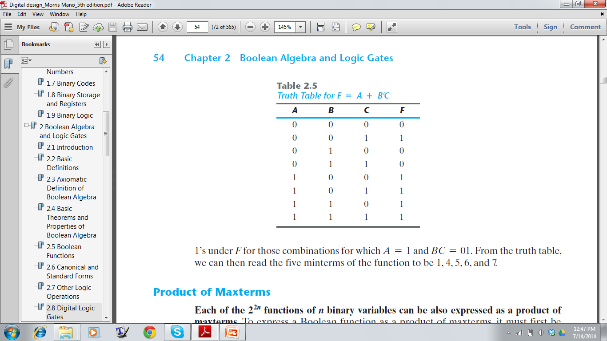
Conversion to Canonical Form
Express the Boolean function F = A + B’C as a sum of minterms.
Process: 2
Draw the Truth Table
Read the minterms from the truth table
F = m1 + m4 + m5 + m6 + m7

Slide 17
Conversion to Canonical Form
Express the Boolean function F = xy + x’z as a product of maxterms
Process: 1
Convert the function into OR terms using the distributive law
F = xy + x’z
= (xy + x’) (xy + z)
= (x + x’)(y + x’) (x + z)(y + z)
= (x’ + y)(x + z)(y + z)
For each missing variable P, add the PP’ with each term, until all the variables appear in each term.
F = (x’ + y)(x + z)(y + z) = (x’ + y + zz’) (x + z + yy’) (y + z + xx’)
= (x’ + y + z)(x’ + y + z’) (x + y + z)(x + y’ + z) (x + y + z)(x’ + y + z)
= (x’ + y + z)(x’ + y + z’) (x + y + z)(x + y’ + z)
Distributive Law:
X(Y+Z) = XY + XZ
X+(YZ) = (X+Y) (X+Z)

Slide 18
Conversion to Canonical Form
Express the Boolean function F = xy + x’z as a product of maxterms
Process: 2
Draw the Truth Table
Read the maxterms from the truth table
F = M₀M₂M₄M₅
X | Y | Z | F
0 | 0 | 0 | 0
0 | 0 | 1 | 1
0 | 1 | 0 | 0
0 | 1 | 1 | 1
1 | 0 | 0 | 0
1 | 0 | 1 | 0
1 | 1 | 0 | 1
1 | 1 | 1 | 1

Slide 19
Standard Form
Each term in the function may contain one, two, or any number of literals F = y + xy + xyz
Either the sum of products or the products of sums, not both!
F = AB + C(D + E) ➔ Non Standard Form
= AB + CD + CE ➔ Standard Form
Some Standard Functions:
F₁ = y’ + xy + x’yz’ (sum of products)
F2 = x(y’ + z)(x’ + y + z’) (product of sums)

Slide 20
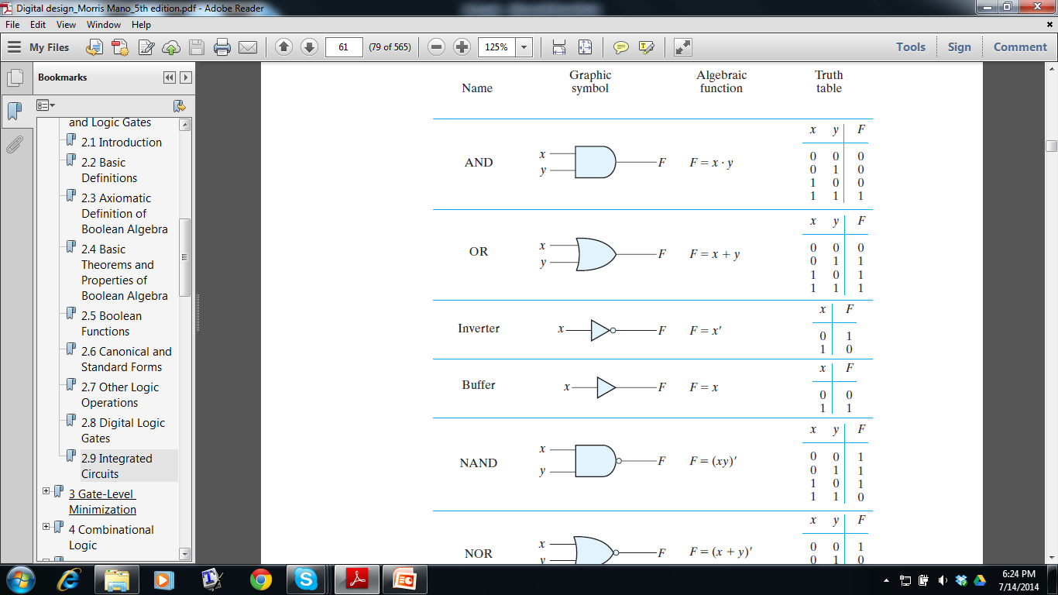
Common Logical operations

Slide 21
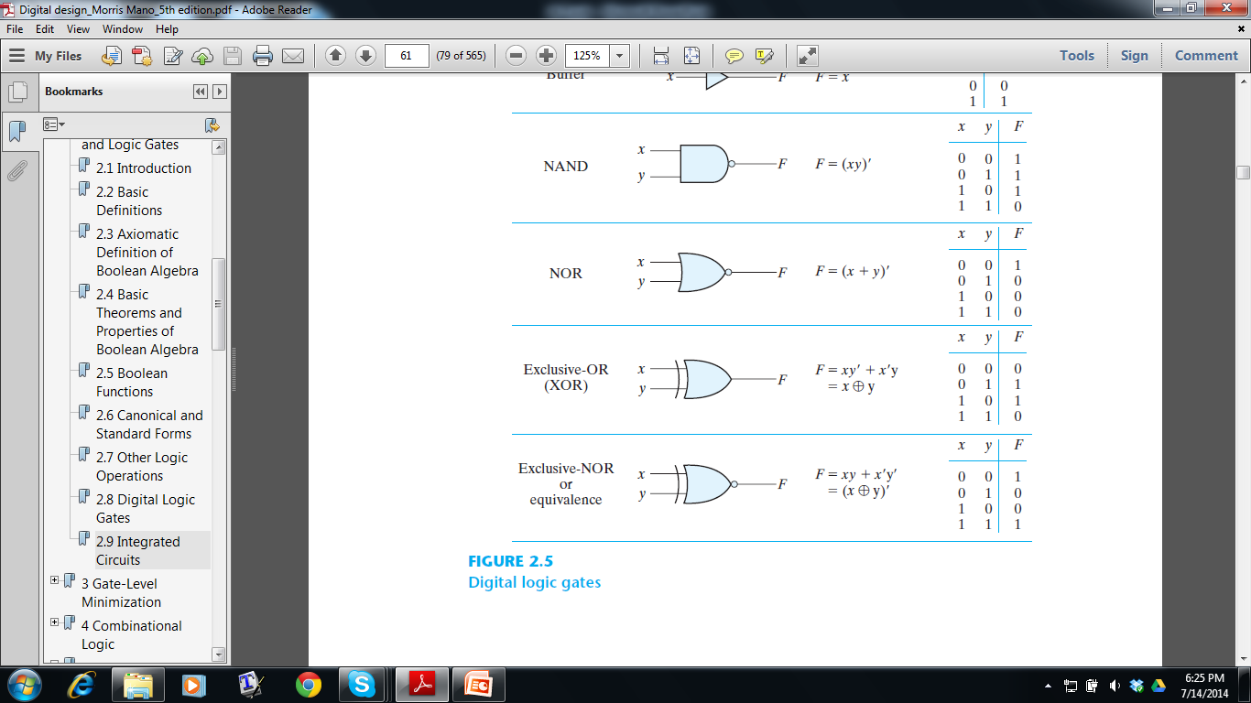
Common Logical operations

